Slide 1
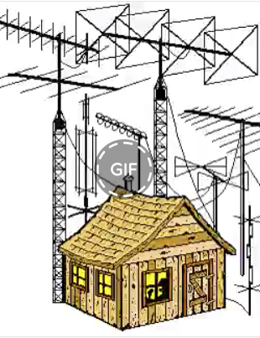
HF Operating: Getting on the HF bands
Bill Shanney, W6QR

Slide 2
Topics
Why HF?
Equipment overview
Transceivers
Antennas
Accessories
Using Propagation Data

Slide 3
Technician HF Privileges
Technician Class Hams have Voice privileges on 10M and CW privileges on 10, 15, 40 and 80M. RTTY and Data modes like PSK are allowed on 10M as well
HF is still the only place to get real hands-on experience (In my opinion)
Simple wire antennas are small, inexpensive, easy to build and put up
Transceiver kits are still available
When 10M opens a simple station and antenna can easily work around the world
During the rise and peak of Solar Cycle 25 the band is open most days from 10AM to 4PM
Morning openings to Europe
Afternoon openings to Japan and Australia
A 100W radio and a simple antenna is all you need

Slide 4
Other Thoughts
29.6MHz is popular for FM operation. DX stations are often on during band openings
6M sporadic E operation is very exciting
Cross USA operation with low power and simple antennas
Several HF rigs also have VHF/UHF SSB capability for contesting, satellite and weak signal operation
IC-7100
FT-991A
Once you have your Technician class license it is easy to upgrade to General class. The theory is the same difficulty level plus there are a few frequencies and HF specific facts to memorize.
Provides access to all the HF bands
Different bands are good for different types of operation at different times of the day
HF provides both short & long-haul emergency comm.

Slide 5
Why HF??
During the rise and peak of the solar cycle HF provides worldwide communications around the clock. 10M is only part of the picture
80M provides local communications all day and is the only band open for local contacts all night
40M provides stateside and worldwide communications in the early mornings and evenings
20M opens for stateside and worldwide communications mid morning and stays open into the evening hours
15 and 17M are great bands for worldwide communications all day
Many new General Class Hams will use SSB on these bands. Some will eventually learn the advantages of CW and learn Morse Code.
General Class operators also have digital privileges on all bands, by far the most used modes by upgraded hams.

Slide 6
What does it take to get on HF?
An entry level transceiver
ICOM IC-7300
Kenwood TS-590SG
Yaesu FT-710
Used or borrowed transceiver
The performance of the transceivers on the market today is excellent. Ergonomics is very important, control layouts and menus differ
Buy a used rig; many older transceivers are more than adequate for beginners, plus you get more features for your buck
Borrow a rig from a friend, most hams have extra rigs
You don’t need a lot of bells and whistles to get started, especially on 10M SSB.
I would suggest getting a radio that works on 6M since that is another interesting band
A simple dipole 15-20’ high will work fine
33’ long for 20M
16.5’ long for 10M
9.2’ long on 6M

Slide 7
What does it take to get on HF? (cont’d)
Most rigs need external 12.8volt power at ~20 amps
I recommend a safety ground
Microphone; most rigs come with a decent MIC
Yamaha CM500 headset is an inexpensive alternative (~$50)
Heil microphones are the gold standard
Headphones; inexpensive stereo headphones work well.
Speech only requires ~100Hz to 3KHz bandwidth.
Buy the most comfortable pair you can
Start simple and add accessories when you find a need

Slide 8
Basic Station Set-up
What are your goals and interests?
DXing
Rag Chewing
Home brewing, building your own equipment
Contesting
Portable Operating
QRP (<5W)
Each of these lead to different equipment and/or antenna decisions
What modes do you want to work? (CW, SSB, Digital)
What is your budget?
How much space do you have for your shack and antennas?

Slide 9
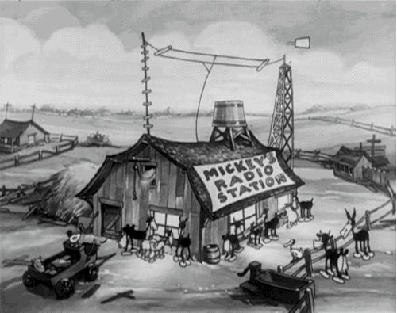
HF Station Requirements Overview
Most folks think of a transceiver first. This is OK because it is the most expensive item you will need, but it is not the most important in terms of making contacts.
The Antenna is the most important item when it comes to putting out a signal.
Other considerations include:
Operating bench and its location. Many hams have no home station and only operate portable or mobile.
Basic understanding of propagation. You need to know when to get on each band so you can make contacts
Station grounding for safety and RF
Accessories such as a MIC, key, VSWR/Power meter, antenna tuner, etc.

Slide 10
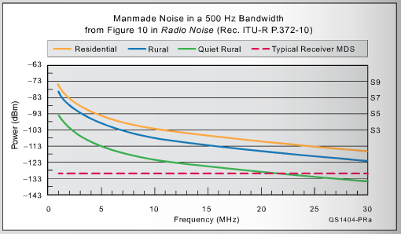
Transceivers
We are very fortunate to have so many excellent transceivers to choose from
I agree with Rob Sherwood, NC0B, that a 90dB Third Order Dynamic Range (DR3) is adequate for most stations. This provides margin for stations with a triband Yagi up 50’ or so.
You only need this much dynamic range on 10M since the lower frequency bands have higher noise levels which limit weak signal sensitivity

Slide 11
Receiver Performance Summary
**Res.
QRN
Table 1: Dynamic Range by Radio
2 kHz Spacing DR3 | Signal Level Causing 3rd Order IMD = Noise Floor* | Radios in This Class
55 dB | S9 | FT-757
60 | S9+5 dB | FT-101E
65 | S9+10 dB | KWM-380 | FT-2000 | FT-1000D
70 | S9+15 dB | TS-830 | FTdx1200 | IC-761
75 | S9+20 dB | IC-756 Pro II/III TS-850 | IC-7410/7600 /7700 | FT-950 FT-450D IC-781
80 | S9+25 dB | Ten-Tec Omni VI+/VII | IC-7800 IC-765 | FTdx3000
85 | S9+30 dB | R9500, IC-705 | TS-990/590S | FTdx9000
90 | S9+35 dB | Ten Tec Eagle Ten Tec Orion I | FLEX 6400 | TS-590SG
95 | S9+40 dB | Ten-Tec Orion II | IC-7300 IC-7610 | Flex 6600 /6700
100 dB | S9+45 dB | Elecraft K3, K4 KX3, TS-890, FT-710 | FTdx5000, FTdx101D FTdx10 | IC-7851 Apache ANAN 7000DLE
40M
20M
CW needs
10M
Vertical or
Low Dipole
Ref. Sig.
Level
Yagi up >50’
Big East Coast
Contest Station
*Receiver Noise = -128dBm in a 500Hz BW. Chart Format copied from Rob Sherwood, NC0B
**Dynamic Range requirements are reduced by atmospheric noise at your location.

Slide 12
Other Transceiver Considerations
Over the past 20 years receiver performance has greatly improved
Lower noise frequency synthesizers
Return to down-conversion architectures for higher close in dynamic range
High resolution spectrum scopes
Software defined radios
Transmitter performance was largely neglected
CW waveforms were improved by the new synthesizers and DSP
SSB splatter is still a problem due to the limitations of 12V amplifier designs and solid-state power amplifiers
The ARRL and Rob Sherwood have been pushing radio manufacturers to improve transmitter designs
PA0Q has published a transceiver summary emphasizing SSB distortion https://www.remeeus.eu/hamradio/pa1hr/productreview.pdf

Slide 13
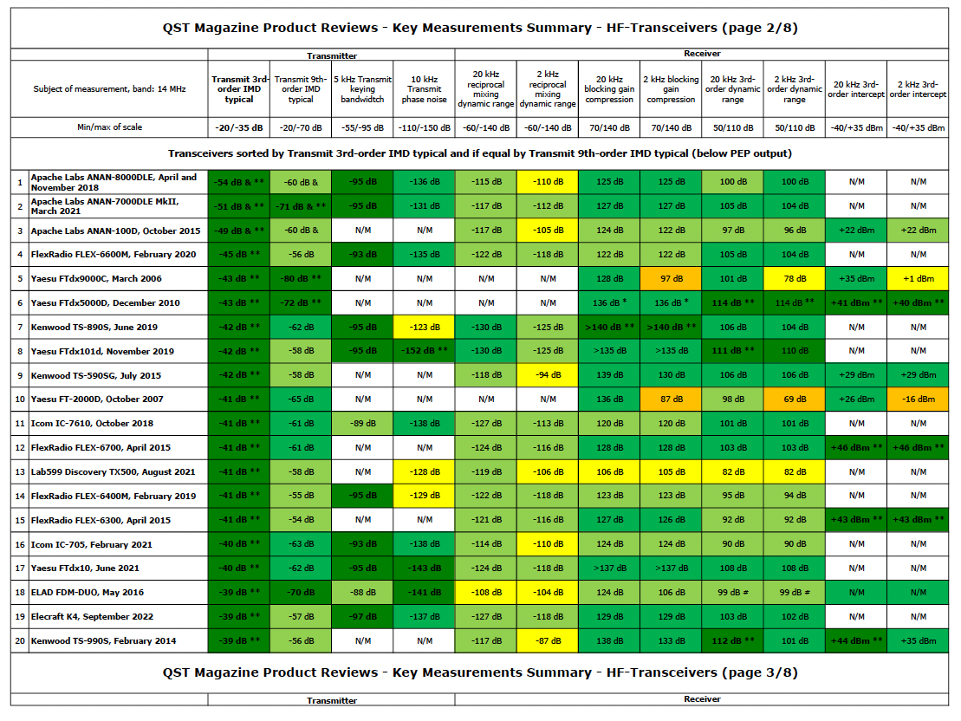
PA0Q QST Product Review Summary

Slide 14
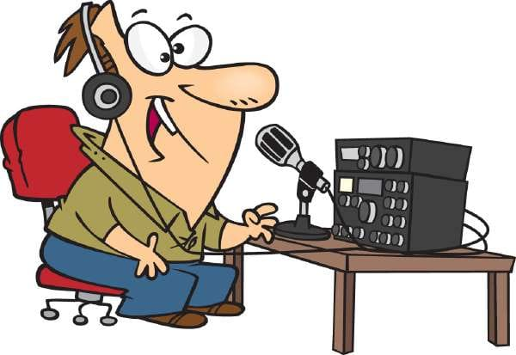
Transceiver Purchase Considerations
If you are considering a new transceiver purchase, I urge you to review the QST Product Reviews, Rob Sherwood’s summary and PA0Q’s data summary.
If you are a CW operator look for CW features like an audio peaking filter and the ability to set the rise time to a value >6msec to prevent key clicks
If you are an SSB operator look at the transmit IMD which causes splatter. Splatter can easily double the signal bandwidth
SSB operators may also want a transceiver with good receive audio performance

Slide 15
Operational Considerations
Power amplifiers also add to transmit intermodulation distortion
Improper drive and ALC settings can make this worse
Solid state amplifiers have higher IMD than tube amplifiers
I’ve used both solid state and tube amplifiers and have found the time to retune a tube amplifier when changing bands is less than 30 seconds once you have determined the dial settings.
Tube amplifiers can be tuned into a 2:1 VSWR with no problems, solid state amplifiers require a lower VSWR or a high-power tuner.
Have a friend look at your transmit signal to make sure it is adjusted properly. Many hams overdrive the amp which increases IMD
100W transceivers can have high AM noise when backed off to drive an amplifier. This can be a problem for high gain amplifiers. This is not tested in the QST product reviews.

Slide 16
Radio Buying Considerations
What activities do you participate in?
Casual Operation, rag chewing
DXing
Contesting
Primarily CW
Primarily SSB
Primarily Digital
Portable
Remote station
What is your experience level?
Beginner
Experienced
Expert
What is your budget?
Ergonomics. The radio must be fun to operate.
Buy a radio that meets your needs, not someone else’s. Buy
one that you understand and is fun to use

Slide 17
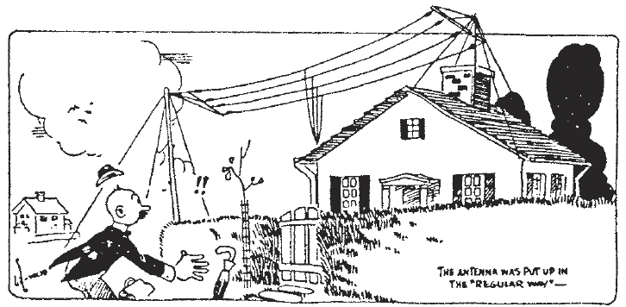
Antenna Overview: It’s All About The Antenna
The most important part of a HF station is the antenna
The antenna couples radio frequency energy to free space in both directions, transmit and receive
I’m going to use a dipole as my example. Adding more elements like a Yagi adds gain by reducing the azimuth angle, it does not change the elevation angle which is important for DXing
Changing the feed point of a dipole does not change the radiation pattern. Traditional center fed dipoles have the same patterns as End Fed Half Wave Dipoles or Offset Fed Dipoles
Changing the shape of a dipole does alter the radiation pattern
Antenna Modelling is the best way to predict
performance for your antenna configuration

Slide 18
Dipole Configurations
λ/4
λ/4
Apex angle
<120 deg.
1:1 Balun
1:1 Balun
λ/4
λ/4
Dipole
Inverted-V
Coax to
Shack
Coax to
Shack
1:1 Balun
Multi-band Dipoles
Ladder Line
to Shack
Coax to
Shack
Balun
Antenna Tuner

Slide 19
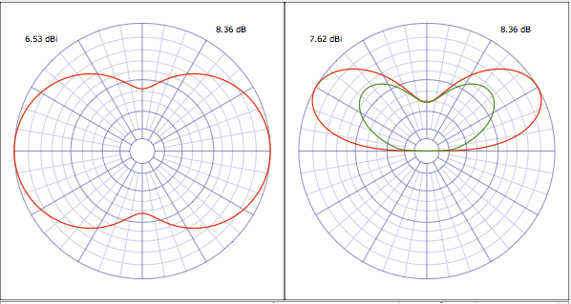
20M dipole up 33’
Azimuth Pattern
Elevation Pattern
Red is broadside pattern
Green is off the ends

Slide 20
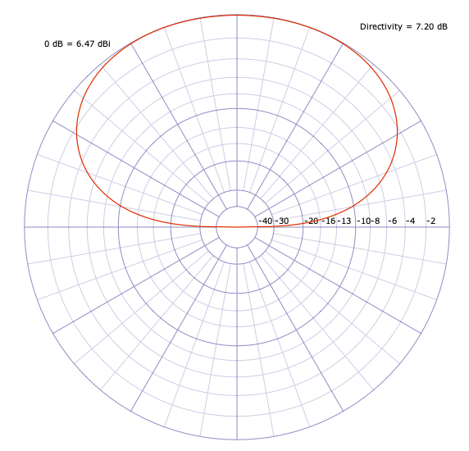
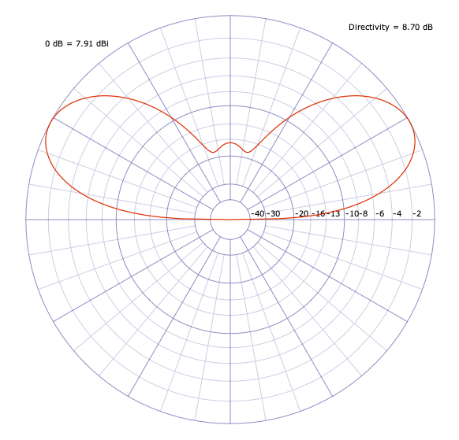
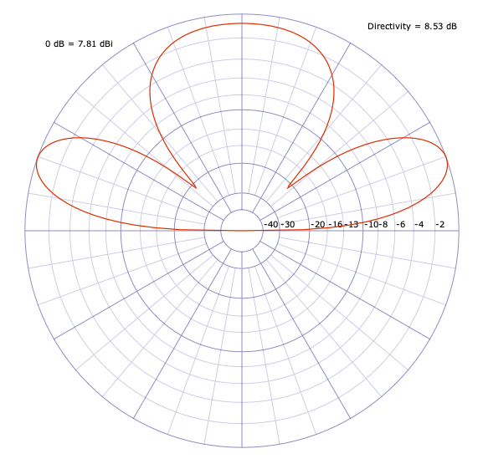
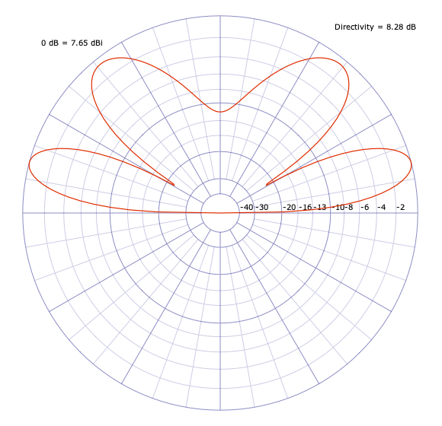
20M Dipole Performance vs. Height
UP ƛ/4
UP ƛ/2
UP 3ƛ/4
UP ƛ

Slide 21
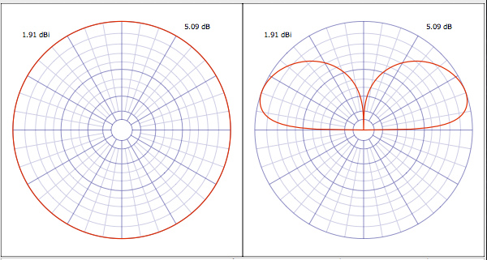
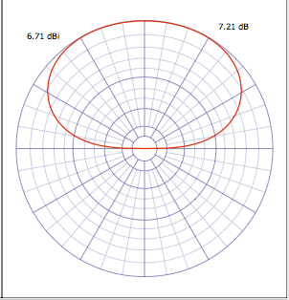
Quarter Wave Vertical
The analysis shows 40M performance with 16
counterpoise wires
Lower gain than a dipole
Lower radiation angles
Less high angle radiation, poor for local contacts
λ/4 Vertical
Balun
λ/4 Counterpoise
λ/4 Counterpoise
Low Dipole Reference
Brewster Angle

Slide 22
Dipole vs. Vertical Antenna Comparison
Radiation Angle | Single Hop Distance (miles) |  | Antenna Gain (dB)
(degrees) | f1 layer | f2 layer | Vert on Gnd | Dipole
 |  |  |  | @ λ/4 | @ λ/2
5 | 1200 | 2300 | -7 Note 1 | -8 | -4
10 | 800 | 2000 | -4 Note 1 | -4 | 2.5
20 | 500 | 1200 | -1 | 1 | 6.5
30 | 300 | 800 | -1 | 4 | 7
40 | 240 | 650 | -2 | 5 | 6
50 | 200 | 500 | -3 | 6 | 4
60 | 200 | 400 | -5 | 6 | 1
Note 1: At frequencies >7MHz over average ground there is very little radiation <15º due to the
pseudo-Brewster angle effect. Modeling is not always accurate in this range.

Slide 23
End Fed Half Wave (EFHW) Antennas are very popular due to their multi-band performance
Coax to
Shack
ƛ/2 wire at the lowest frequency
49:1 Transformer
An EFHW is a wire antenna resonant on its ƛ/2 frequency and harmonics
A 40M EFHW is resonant on 40/20/15/10M
The end impedance is ~2500Ω and varies a bit due to wire orientation
To get proper resonance on the harmonics a coil and capacitor are required
A counterpoise is required. If you don’t install one, the coax will act as the counterpoise
The radiation pattern is dipole like on the fundamental frequency and multi-lobed on harmonics

Slide 24
End Fed Half Wave Antenna (EFHW)
The EFHW antenna is very popular for many reasons
Flexible installation
Straight Horizontal
Straight Vertical
Inverted-V
Inverted-L
Sloper
Operates on harmonics. A 40M EFHW will have a low VSWR on 40/20/15/10M with an appropriate loading coil
End feeding allows smaller wire to be used since you don’t have to support the feedline
Low cost, easy to home brew
The EFHW is not the popular multiband offset fed wire using a 9:1 balun

Slide 25
EFHW Configuration – cont’d
XFMR
XFMR
Horizontal Wire
Sloping Wire
XFMR
XFMR
Inverted V
Inverted L

Slide 26
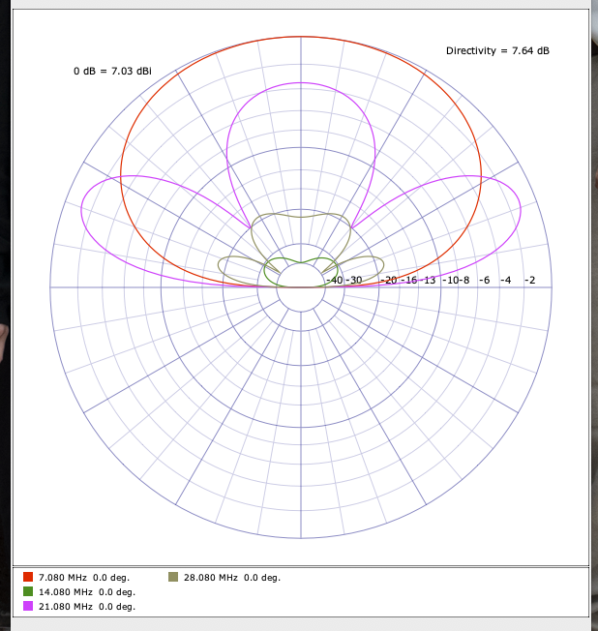
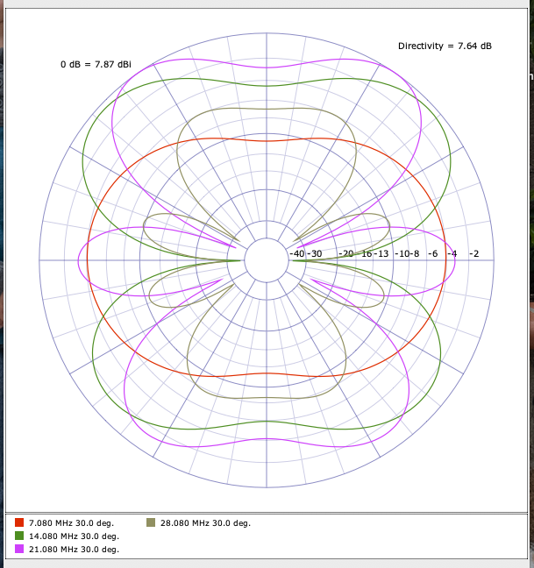
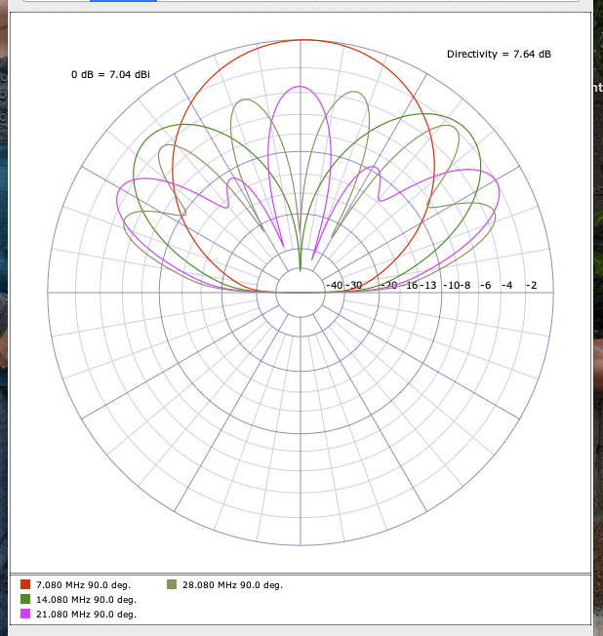
EFHW Radiation Patterns: Horizontal 40M EFHW at 30’
Broadside
Azimuth pattern at 30º elevation
Antenna Oriented up/down
Much of the radiation is off the ends,
orienting the antenna that way is best
End Fire

Slide 27
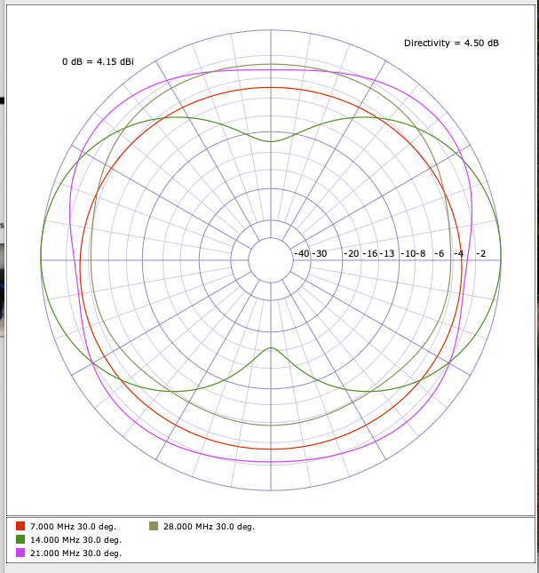
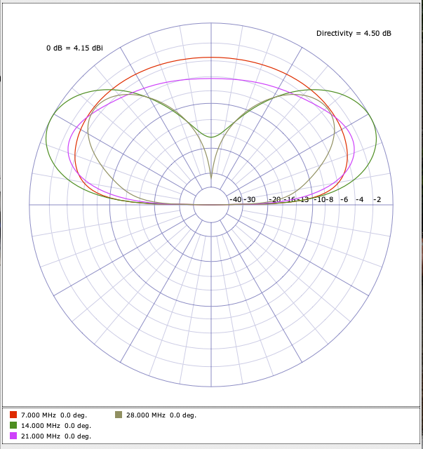
40M EFHW Inverted L
The Inv-L configuration is particularly good. The 20M peak occurs broadside
to the top wire. There is a very good balance of low and high angle radiation.

Slide 28
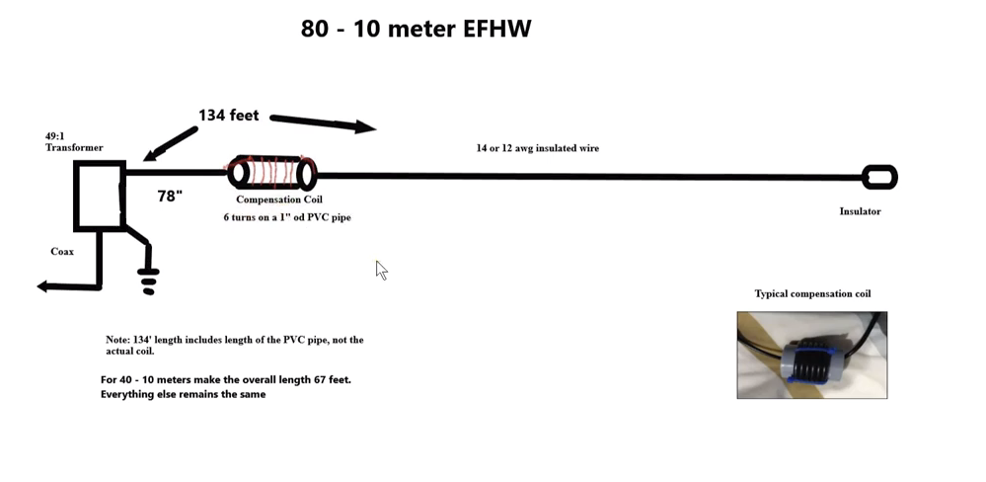
What is an End Fed Half Wave Antenna
Counterpoise
The compensation coil is required to have a proper resonant frequency at harmonics, it compensates for end effects
N4LQ, Steve Ellington, has a lot of data on his Face Book and You Tube pages.
Commercial versions are available for those who don’t like building things
LDG sells an inexpensive low power transformer
The ARRL has a very nice Kit available but does not talk about the coil

Slide 29
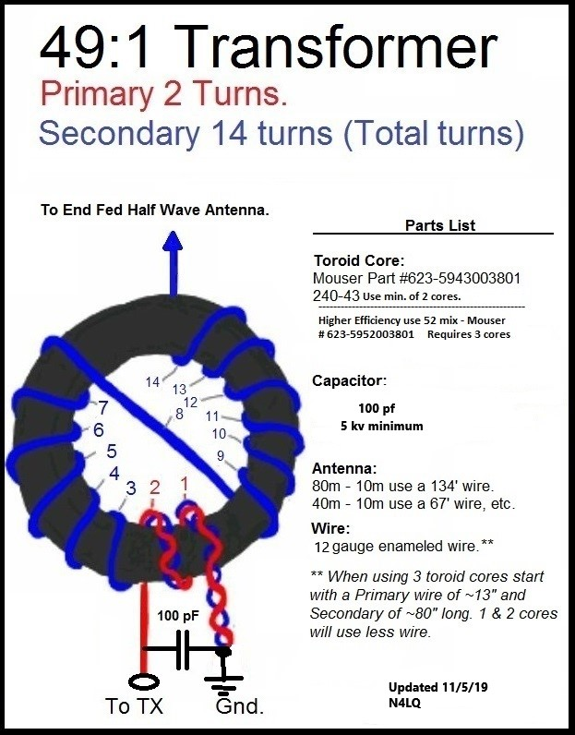
EFHW Components are easy to build
A single FT-140-43 core will handle 100W CW/SSB
One FT-240-43 core will handle 250W (ARRL kit)
Two FT-240-43 cores will handle 500W
Three FT-240-52 cores will handle 1500W
Careful layout is required for high power operation since the voltage at 2500Ω is quite high, several KV.

Slide 30
EFHW Summary
End Fed Half Wave Antennas are a good choice for hams with limited space who want multi band coverage
They are stealthy and can be installed in a variety of configurations
They have a good VSWR on their resonant bands
A short counterpoise or line isolator close to the transformer is recommended
A line isolator should be used at the transmitter.

Slide 31
References and Resources
The ARRL Handbook
The ARRL Antenna Book
HF Antennas for All Locations by Les Moxon, G6XN (SK)
The Little Pistol’s Guide to HF Propagation by Bob Brown, NM7M (SK), free download on K9LA’s web page
Propagation Predictions and Courses: Tamitha Skov, The Space Weather Woman: https://www.youtube.com/c/TamithaSkov
NOAA Space Weather website: https://www.swpc.noaa.gov
VOACAP for Ham Radio: https://www.voacap.com/hf/
Rob Sherwood’s Transceiver Performance Summary: http://www.sherweng.com/table.html

